Slide 1
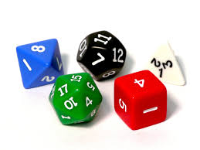
Probability Interactive Notebook
Name
Class
Teacher
Term 1 Semester 1
1

Slide 2
Contents
Glossary or Formula Page
Page
Date
Description
2
3

Slide 3
Tasks
24
7
30
Essential Question
Questions
Notes
Summary
4
5

Slide 4
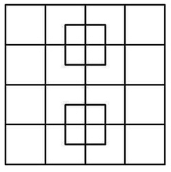
How many squares are there?

Slide 5
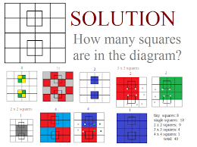
40 squares

Slide 6
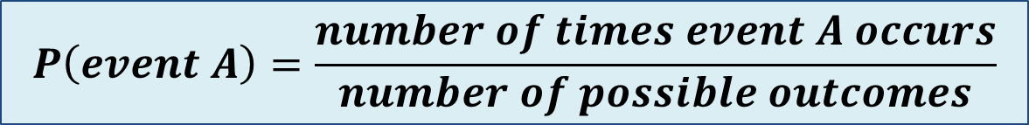
24
7
30
Date
Theoretical probability
EQ – How can you determine theoretical probability?
What is theoretical probability?
Theoretical probability is the chance of an event occurring
$$P\left(event A\right)=\frac{number of times event A occurs}{number of possible outcomes}$$
Example :
Example: if there are 10 marbles in a bag, 6 are red, 3 are green and 1 is blue. If a marble is randomly pulled out of the bag determine the following
P(red marble) =
P(Green marble) =
P(yellow marble) =

Slide 7
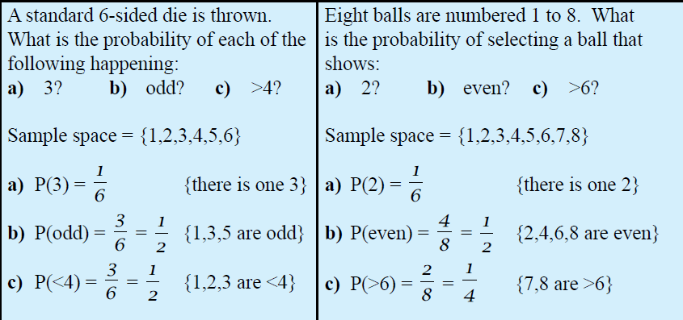
Let’s try these together

Slide 8
Task
Dwyer text book
Page 54

Slide 9
Homework
Review your notes and write a summary answering the essential question.

